Slide 1
Image Processing Review Fall Detection System for the Elderly using YOLO Algorithm
Team Members:
Mounika Pokala (19BCE1561)
Sriram Namana (19BPS1072)
Abishek S (19BCE1686)

Slide 2
Introduction
Falling is one of the scariest events elderly people may experience which sometimes can prove to be fatal. As the ‘elderly population’ increases, there is a growing need for a fall detection system to alert the system admins regarding such an event.
The main objective of the ‘Fall Detection’ module is to send alerts to the system admin whenever a fall is detected.
The ‘Fall Detection’ module should mitigate the adverse consequences of a fall by sending immediate alerts and images of the fall when detected.

Slide 3
Introduction
To implement the ‘Fall Detection’ module, we will be using the YOLO algorithm to detect the incident. In this module, we take the input video from a source and divide the video into several frames.
If the fall is detected continuously in 20 frames of the video, then an alert is sent to the system admin. The alert is in the form of an email which includes the detected picture.

Slide 4
Existing Solution
Numerous methods have been developed to detect falls in the elderly, but the most widely used and adopted solution is the wearable-device-based method.
Wearable Device Based Method:
With the wearable device innovation, there are approaches that have been proposed for fall assessment, prevention, and detection that use wearable devices and implemented methods that adopted triaxial accelerometers to collect fall signals.
Limitations:
Works only with an active internet connection.
It requires the use of a battery.
Uncomfortable to use.

Slide 5
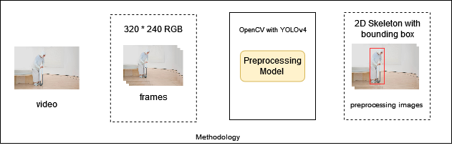
Our Solution

Slide 6
Module description
YOLOv4 Algorithm:
We are using YOLOv4 with the GPU. YOLOv4 is an object detection algorithm that is an evolution of the YOLOv3 model. We are using this model to detect the object in real time and the bounding boxes with OpenCV is then used to detect whether there is a fall or not.
Bounding Boxes with OpenCV:
This library is used to solve computer vision problems. We are using the cvDrawBoxes() to draw boxes around the detected object. It draws and calculates the width and height of the bounded person in realtime.

Slide 7
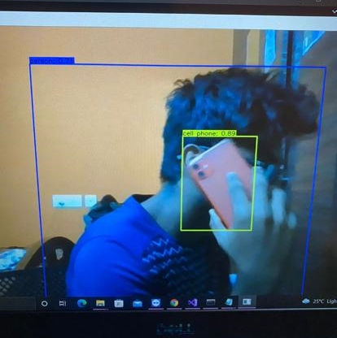
Implementation
We have enabled GPU processing using NVIDIA’s CUDA programming.
We have also completed the Splitting of the frames from a video using OpenCV Library in Python.
We have also enabled the analysis of the frames and detecting the objects present in the frame in real time.

Slide 8
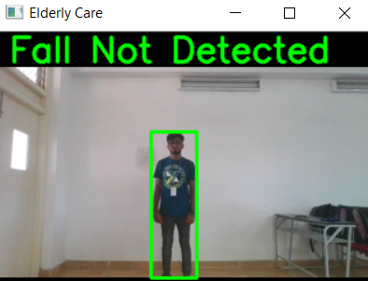
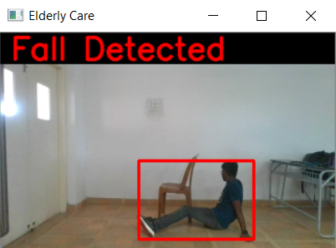
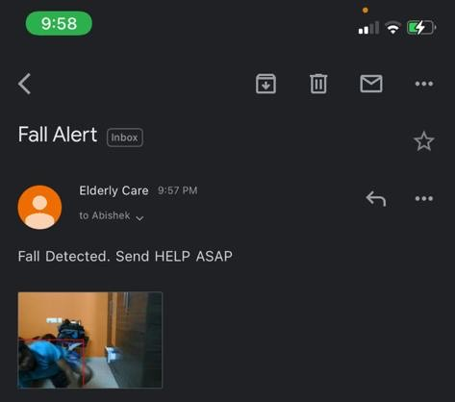
Implementation
We now have to segregate the human from the frame and create a bounding box around them.
Now with respect to the bounding box formed around the human, we have to determine whether the person is undergoing a fall or not. For this, we can use the length and breadth of the bounding box and the number of frames in which the movement happens.

